Slide 1
Special sense
DR. Massara Ghassan

Slide 2

Visual acuity
Is the degree to which the details and contour of objects are perceived
i.e the shortest distance by which two lines can be separated and still be perceived as 2 lines

Slide 3
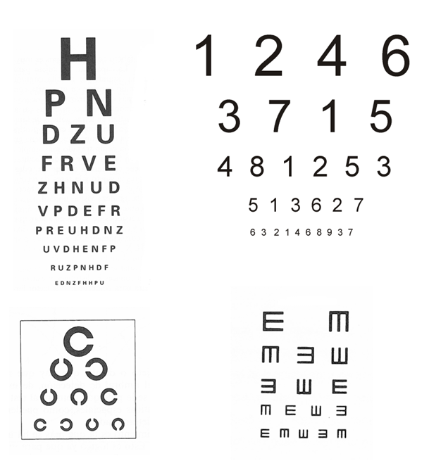
Measurement
By the use of the Snellen chart
Types of chart :-
Letters
Numbers
Snellen “E”
Landolt Rings

Slide 4
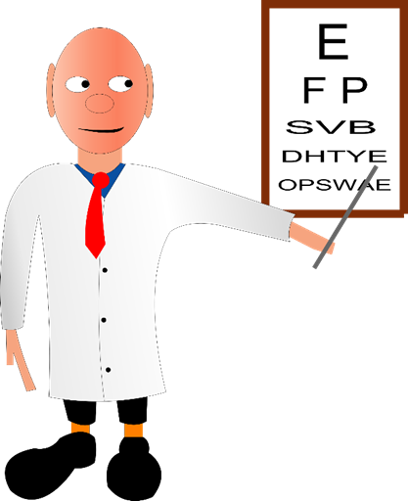
Standard Test Distances
the standard chart distance is 6 metres (20 ft), and normal acuity is designated "6/6"
20ft or 6M
Numerator = distance
6
6
Dominator = the number of the smallest line that a person can read

Slide 5
Expected Findings
Not able to read any line from 6M distance
repeat the test from 5M
4M
3M
2M
1M

Slide 6
Q1.what is the way that is usually used to score VA ?
Q2. What do you do if the patient can’t see the biggest letter?
Q3. What do you do if the patient can’t see the biggest letter from a distance of 1 meter away from the chart?

Slide 7
Color vision Color vision>>>>>cones
There are 3 types of cone pigments
Types peak absorbance at
1. blue sensitive pigments. 440 nm
2. green sensitive pigments. 535 nm
3. red sensitive pigments. 565 nm

Slide 8
Color blindness
Type of inheritance
Gene for blue sensitive pigments >>> chrom 7
Gene for green and red sensitive pigments >>> x linked recessive
Male > female
Green, yellow, orange and red colors ( 525 nm -675nm) are normally distinguishable by red and green pigments
Test >>>> ishihara test

Slide 9

Why do we test hearing?
Is the hearing normal?
What type of hearing loss is it?

Slide 10
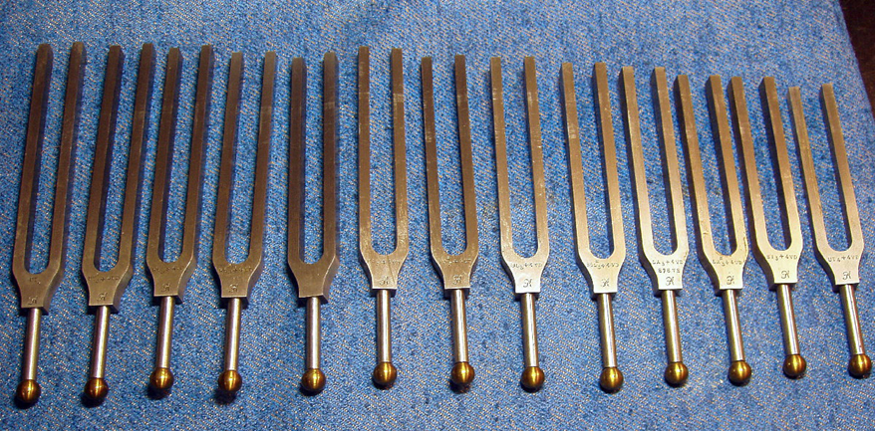
Tuning fork tests
They allow one to distinguish between conductive and sensorineural deafness
Rinne´s test
Weber´s test

Slide 11
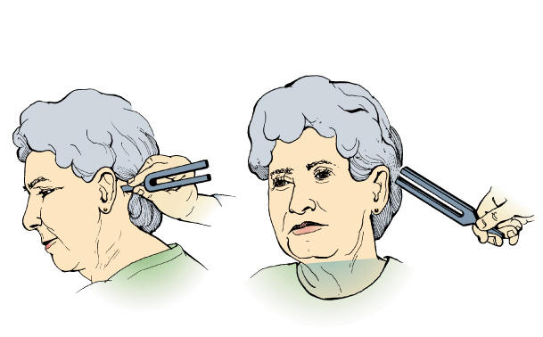
Rinne´s test
Procedure
The Rinne test is performed by placing a high frequency vibrating tuning fork against the patient's mastoid bone and asking the patient to tell you when the sound is no longer heard.

Slide 12
Once they signal they can't hear it, quickly position the still vibrating tuning fork 1-2 cm from the auditory canal, and again ask the patient to tell you if they are able to hear the tuning fork.

Slide 13
Results
Air conduction >bone conduction
Normal Hearing:.
conductive hearing loss
Air conduction <bone conduction
sensorineural hearing loss
Air conduction >bone conduction
In sensorineural hearing loss , the patient appear like normal person so this test must accompany by Weber test to also detect sensorineural hearing loss

Slide 14
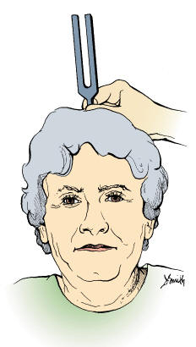
Weber´s test
Procedure
a vibrating tuning fork is placed in the middle of the forehead

Slide 15
Results
A normal weber test has a patient reporting the sound heard equally in both sides
A patient with a unilateral conductive hearing loss ( air conduction defect ) would hear the tuning fork loudest in the affected ear
A patient with a unilateral sensorineural hearing loss ( bone conduction defect ) would hear the sound louder in the unaffected ear

Slide 16
FOR EXAMPLE
: if the RT . ear hears the sound louder than the left one this indicate
either : air defect in RT
or : bone defect in left
so Rinne´s test must done for RT ear

